Slide 1

SQL - 4
Gerry Guinane
Limerick Institute of Technology
Topic 3 SQL Lecture 04

Slide 2
Learning outcomes
Learning outcomes – the student will be able to
use aggregate functions in SQL including SUM, AVG, MAX, MIN and COUNT
Use the HAVING sub-clause
Explain advantages and disadvantages of stored procedures
Create and use basic stored procedures in MySQL using MySQL Workbench
Use SQL IF..ELSE control of flow statements

Slide 3
SQL Aggregate Functions
Sometimes the information we need is not actually stored in database tables but we can retrieve it by computing on fly from stored data.
For example, if we would like to find out the total of all parts required by a given project by part number.
Aggregate functions help you to answer those kind of questions.
Aggregate functions are usually used with a GROUP BY sub clause

Slide 4
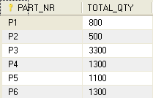
SUM Function
Syntax: SUM(expression)
SUM function returns the sum of all values in an expression.
Query
Result
SELECT
PART_NR,
SUM(REQUIRED_QTY)AS TOTAL_QTY
FROM
project_parts_required
GROUP BY PART_NR

Slide 5
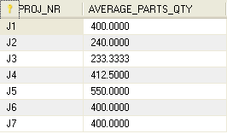
AVG Function
Syntax: AVG(expression)
AVG function returns the average of all values in an expression.
Query
Result
SELECT
PROJ_NR,
AVG(REQUIRED_QTY) AS AVERAGE_PARTS_QTY
FROM project_parts_required
GROUP BY PROJ_NR;

Slide 6
HAVING sub clause
The HAVING sub-clause is used to perform filtering of results where an aggregate function is used:
SELECT [predicate]
select_expr, ...
[FROM table_references
[WHERE where_condition]
[GROUP BY {col_name | expr | position}
[ASC | DESC], ... [WITH ROLLUP]]
[HAVING where_condition]

Slide 7
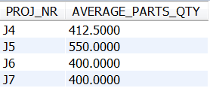
AGGREGATES and HAVING Clause
If you need to filter on an aggregate in a SELECT that uses GROUP BY you cannot use WHERE, you must use HAVING. The HAVING clause comes after GROUP BY.
Query
Result
SELECT PROJ_NR, AVG(REQUIRED_QTY) AS AVERAGE_PARTS_QTY
FROM project_parts_requiredGROUP BY PROJ_NR
HAVING AVG(REQUIRED_QTY)>300;
Try replacing the HAVING with a WHERE sub clause in this example.

Slide 8

MAX and MIN Function
Syntax: MAX(expression), MIN(expression)
MAX function returns the maximum and MIN function returns the minimum value of the set of values in expression.
Query
Result
SELECT
MAX(REQUIRED_QTY) AS MAX_QTY,
MIN(REQUIRED_QTY) AS MIN_QTY,
SUM(REQUIRED_QTY) AS TOTAL
FROM project_parts_required;

Slide 9

COUNT Function
Syntax: COUNT(expression)
COUNT function returns the count of the items in expression. We can use COUNT function to count how many records we have as follows:
Query
Result
SELECT
COUNT(*) AS NUMBER_OF_PARTS FROM parts;

Slide 10
Stored Programs & Views
Stored programs and views - are database objects defined in terms of SQL code that is stored on the server for later execution.
Stored programs include these objects:
Stored routines, that is, stored procedures and functions.
A stored procedure is invoked using the CALL statement. A procedure does not have a return value but can modify its parameters for later inspection by the caller. It can also generate result sets to be returned to the client program.
A stored function is used much like a built-in function. you invoke it in an expression and it returns a value during expression evaluation.
Triggers. A trigger is a named database object that is associated with a table and that is activated when a particular event occurs for the table, such as an insert or update.
Events. An event is a task that the server runs according to schedule.
Views are stored queries that when referenced produce a result set. A view acts as a virtual table.

Slide 11
Stored Procedures
A stored procedure is a segment of declarative SQL code, which is stored in the database catalog.
A stored procedure can be invoked by a program, a trigger or even another stored procedure.

Slide 12
Stored Procedures Advantages
Stored procedure increases performance of application.
Once created, stored procedure is compiled and stored in the database catalog. It runs faster than uncompiled SQL commands which are sent from application.
Stored procedure reduces the traffic between application and database server
because instead of sending multiple uncompiled lengthy SQL commands statements, the application only has to send the stored procedure's name and get the data back.
Stored procedure is reusable and transparent to any application which wants to use it.
Stored procedure exposes the database interface to all applications so developers don't have to program the functions which are already supported in stored procedure in all external applications.
Stored procedure is secured.
Database administrator can grant the access right to application which wants to access stored procedures in database catalog without granting any permission on the underlying database tables.

Slide 13
Stored Procedures Disadvantages
Stored procedures make the database server high load in both memory and processors.
Instead of being focused on the storing and retrieving data, you could be asking the database server to perform a number of logical operations or a complex of business logic which is not the main purpose of database server.
Stored procedure only contains declarative SQL so it is very difficult to write a procedure with complexity of business logic like other languages in application layer such as Java, C#, C++…
Stored procedure is difficult to debug.
You cannot debug stored procedure in most RDMBSs. There are some workarounds on this problem but it still not easy enough to do so.
Store procedure is not easy to write and maintain.
Writing and maintaining stored procedure is usually required specialized skill set that not all developers possess. This may introduced problems in both application development and maintain phase.

Slide 14
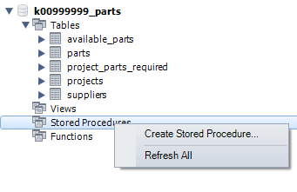
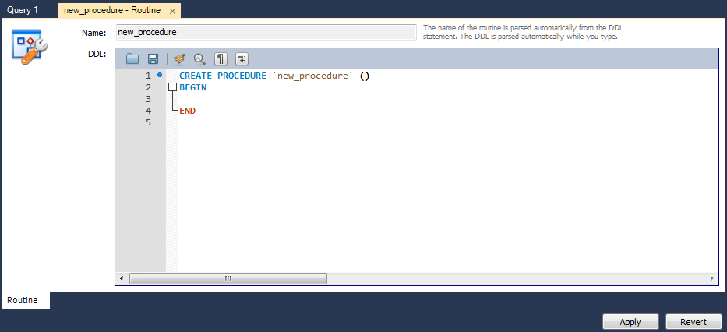
How to create a stored procedure
Open Workbench
Set the CURRENT WORKING DATABASE to the ‘k00xxxxxx_parts’ DB
Expand the Database node , select and right click on Stored Procedures→Create Stored Procedure

Slide 15
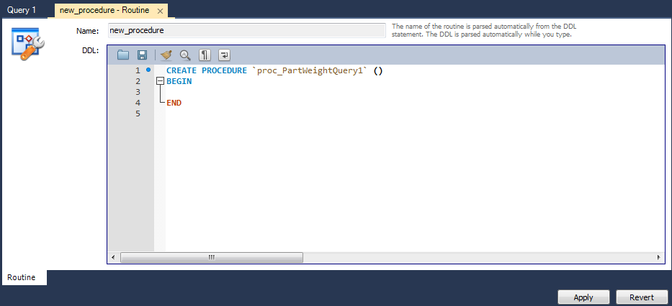
Add name to procedure
Enter a name for the procedure: proc_PartWeightQuery1

Slide 16
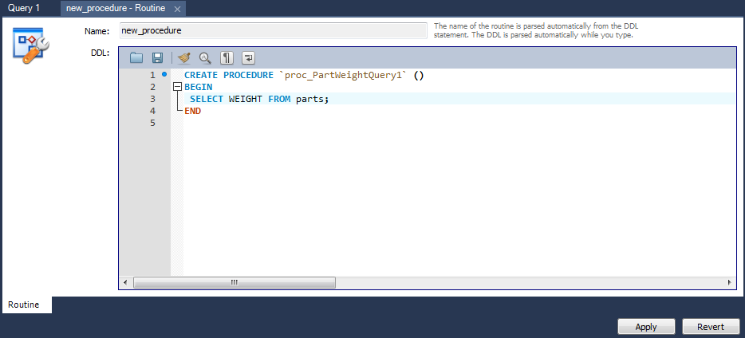
Add code to the procedure – click APPLY

Slide 17
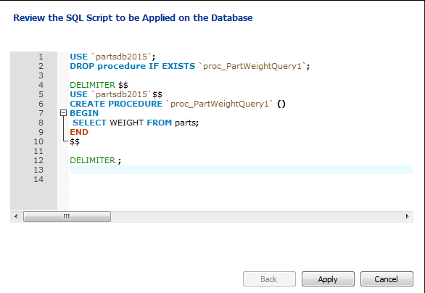
Autogenerated code
View the automatically generated stored procedure
Note the default delimeter in SQL is ‘;’ - this is used to signify the end of an SQL statement
In a procedure an alternative delimeter must be declared for the duration of the CREATE procedure process – in this case ‘$$’

Slide 18
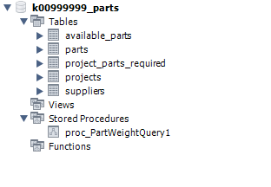
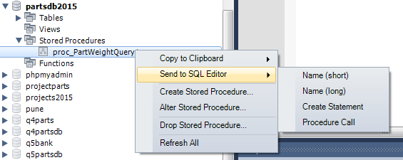
Procedure is now saved and ready for execution
Procedure is now part of the database schema
Call the procedure – right click down to procedure call as shown here
Or type this query:
CALL proc_PartWeightQuery1();

Slide 19
Stored Procedures - Parameters
In MySQL, a parameter has one of three modes: IN,OUT, or INOUT.
IN – is the default mode. When you define an IN parameter in a stored procedure, the calling program has to pass an argument to the stored procedure. In addition, the value of an IN parameter is protected. It means that even the value of the IN parameter is changed inside the stored procedure, its original value is retained after the stored procedure ends. In other words, the stored procedure only works on the copy of the IN parameter.
OUT – the value of an OUT parameter can be changed inside the stored procedure and its new value is passed back to the calling program. Notice that the stored procedure cannot access the initial value of the OUT parameter when it starts.
INOUT – an INOUT parameter is the combination of IN and OUT parameters. It means that the calling program may pass the argument, and the stored procedure can modify the INOUT parameter and pass the new value back to the calling program.

Slide 20

Add a argument/parameter to the procedure
Right click on the procedure -> Alter Procedure
To save the procedure you must hit APPLY
Then call the procedure – this time you must supply a value for the argument

Slide 21


IN…OUT example
Procedure
Call
CREATE PROCEDURE `sp_supplier_parts_count`
(IN suppliernr varchar(10), OUT nr_of_parts INT)
BEGIN
SELECT COUNT(*) INTO nr_of_parts
FROM suppliers s INNER JOIN available_parts ap
WHERE s.s_Nr=ap.SUPPLIER_NRAND s.S_NR='S1';
END

Slide 22
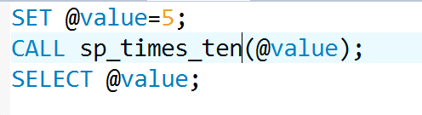

Stored Procedures - Variables
Variables may be declared and initialised using DECLARE and SET or SELECT
Call:
CREATE DEFINER=`root`@`localhost` PROCEDURE `sp_times_ten`(INOUT number INT)
BEGIN
DECLARE myVar INT;
SET myVar=10;
SET number=(number*myVar);
END

Slide 23
Variables Scope
If you declare a variable inside BEGIN END block, it will be out of scope if the END is reached.
A variable that begins with the @ sign is a session variable.
It is available and accessible until the session ends.
It’s scope is only within the session in which it is declared.

Slide 24
Stored Procedures - IF
IF – conditionally executes a BLOCK of SQL
SYNTAX
IF expression THEN
statements;
END IF;
IF expression THEN
statements;
ELSEIF elseif-expression THEN
elseif-statements;
...
ELSE
else-statements;
END IF;
IF expression THEN
statements;
ELSE
else-statements;
END IF;

Slide 25

Example IF..ELSEIF…
See notes page..
Notes:
CREATE DEFINER=`root`@`localhost`
PROCEDURE `sp_check_availability`(IN partnr varchar(10), IN projnr varchar(10), OUT result varchar(40))
BEGIN
DECLARE qty_avail INT;
DECLARE qty_req INT;
SET result='unknown';
SET qty_avail = (
SELECT SUM(ap.QTY)
FROM available_parts ap
WHERE ap.PART_NR=partnr
GROUP BY ap.PART_NR);
SET qty_req = (
SELECT SUM(ppr.REQUIRED_QTY)
FROM project_parts_required ppr
WHERE ppr.PROJ_NR=projnr
AND ppr.PART_NR=partnr
GROUP BY ppr.PART_NR);
IF (qty_req IS NULL)
THEN
SET result='Part not used in this project';
ELSE
IF (qty_req>qty_avail)
THEN
SET result='Insufficient parts available';
ELSE
SET result='Sufficient parts available';
END IF;
END IF;
# SELECT partnr,projnr,qty_req,qty_avail,result;
END

